Slide 1
Data Visualization & Exploratory Data Analysis

Slide 2
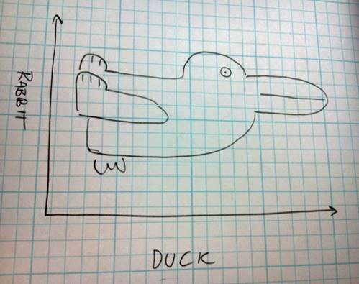

Slide 3
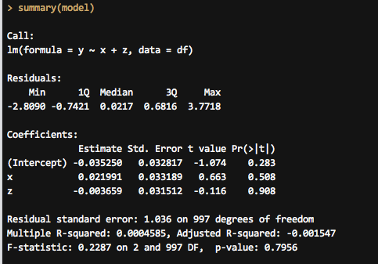
Statistics can be ugly
Why? | Univariate | Multivariate | Models | How?

Slide 4
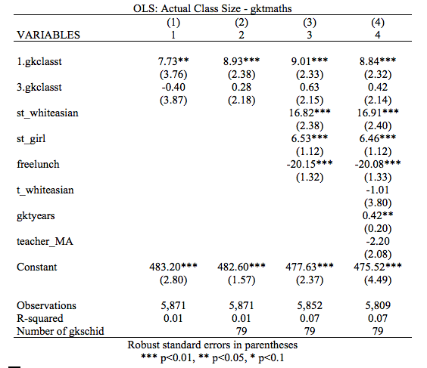
Numbers are scary
Why? | Univariate | Multivariate | Models | How?
Notes:
How many of you read an article with regression coefficients in it in the past few days? Can you tell me what one of those coefficients was?

Slide 5
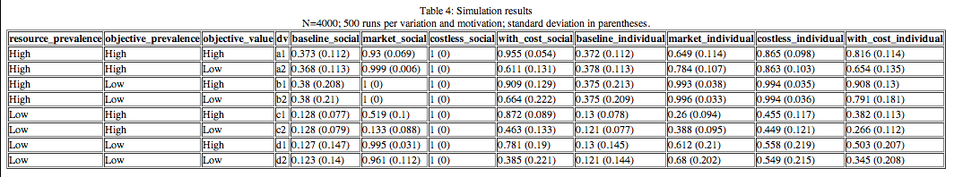
Walls of numbers
Why? | Univariate | Multivariate | Models | How?

Slide 6
Exploratory Data Analysis
“Interocular traumatic impact”
Enhance probabilistic analysis
Check shape and assumptions
Why? | Univariate | Multivariate | Models | How?
Notes:
John Tukey, William S. Cleveland, Joseph Berkson – “Sometimes visualization can fully replace the need for probabilistic inference. We visualize the data effectively and suddenly, there is what Joseph Berkson called interocular traumatic impact: a conclusion that hits us between the two eyes” (via http://development.thinkingwithdata.com/show.php?p=workshop.html)
Rival to forecasting and inferential schools of thought

Slide 7
Right between the eyes…
Why? | Univariate | Multivariate | Models | How?

Slide 8
Right between the eyes…
Why? | Univariate | Multivariate | Models | How?

Slide 9
Right between the eyes…
Why? | Univariate | Multivariate | Models | How?

Slide 10
Two types of visualization
Exploratory
Scatterplots, histograms, etc.
Publishable
Vox, FiveThirtyEight, NYT
Why? | Univariate | Multivariate | Models | How?
Notes:
Publishable far more complicated – we’ll cover that at the end of October – basic graphic design principles + R stuff + some Stata

Slide 11
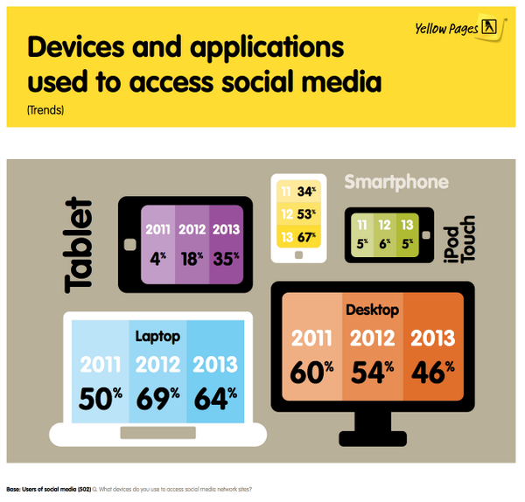
Infographics and chart porn
http://terribleinfographics.tumblr.com/
http://wtfviz.net/
http://vizwiz.blogspot.com/2014/06/makeover-monday-face-pie-taking-analogy.html
https://source.opennews.org/en-US/articles/when-map-shouldnt-be-map/
Why? | Univariate | Multivariate | Models | How?

Slide 12
EDA: Understand your data
Visualize every variable individually
Visualize relationships between variables
Visualize models
Why? | Univariate | Multivariate | Models | How?
Notes:
Before you run any models, check all the variables you’re using

Slide 13
Which visualization do I use?

Slide 14
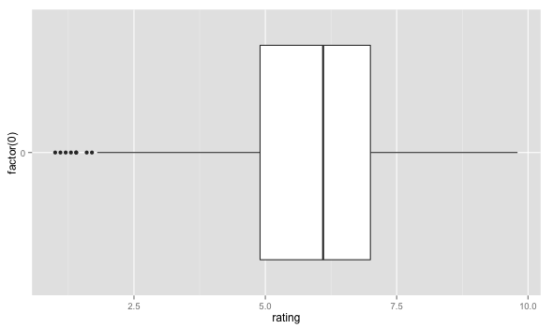
Boxplots
Univariate visualization
Continuous data
Why? | Univariate | Multivariate | Models | How?
Notes:
Shows important parts of the 5-number summary – quartiles + median + outliers (1.5 IQR, 1st–3rd quartiles)

Slide 15
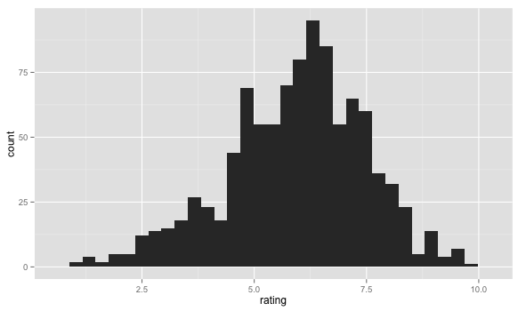
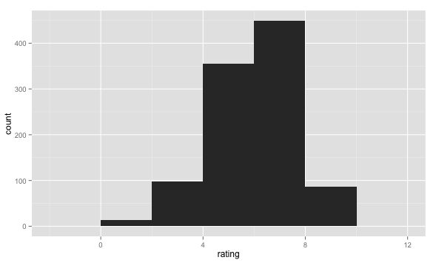
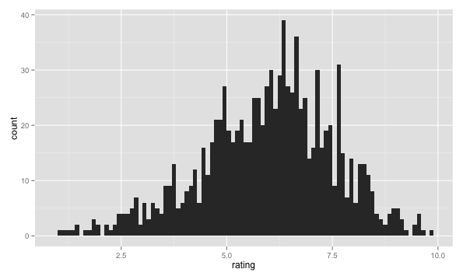
Histograms
Univariate visualization
Continuous data
Why? | Univariate | Multivariate | Models | How?
Notes:
Sticks things in bins, but is dependent on the number of bins

Slide 16
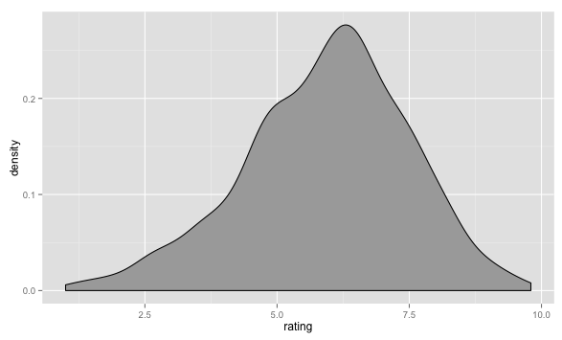
Density plots
Univariate visualization
Continuous data
Why? | Univariate | Multivariate | Models | How?
Notes:
Better, shows a kernel density estimate of the data – better for seeing the actual distribution – best for continuous data

Slide 17
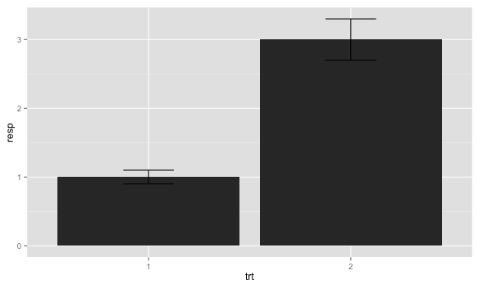
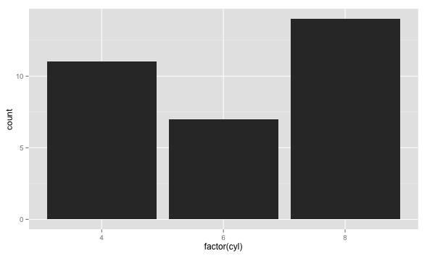
Bar charts
Univariate visualization
Categorical data
Why? | Univariate | Multivariate | Models | How?
Notes:
Bar charts – must start at 0, must not be connected (otherwise it’s a histogram) – good for categorical data

Slide 18
Bivariate visualization
 | Continuous | Categorical
Continuous | Scatterplots | Grouped plots
Categorical | — | Mosaic plots, grouped plots
Pack in as much data as you can
Why? | Univariate | Multivariate | Models | How?

Slide 19
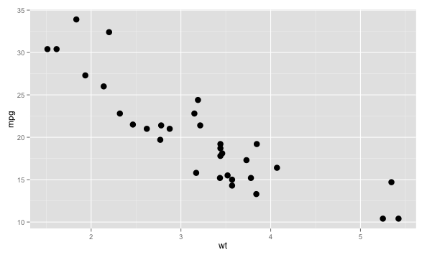
Scatterplots
Bivariate visualization
Continuous + continuous
Why? | Univariate | Multivariate | Models | How?
Notes:
Standard visualization

Slide 20
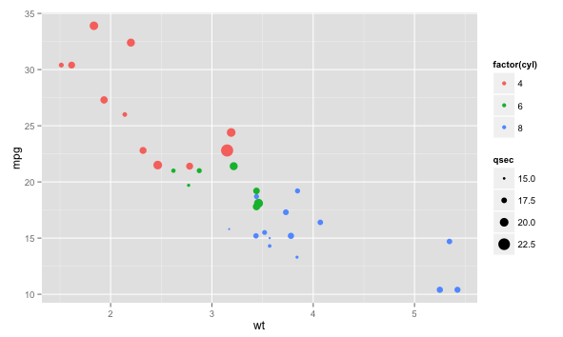
MOAR DATA!!1!
Bivariate visualization
Continuous + continuous
Why? | Univariate | Multivariate | Models | How?
Notes:
Add other parts of your data to get a better understanding of what’s going on
qsec = ¼ mile time

Slide 21
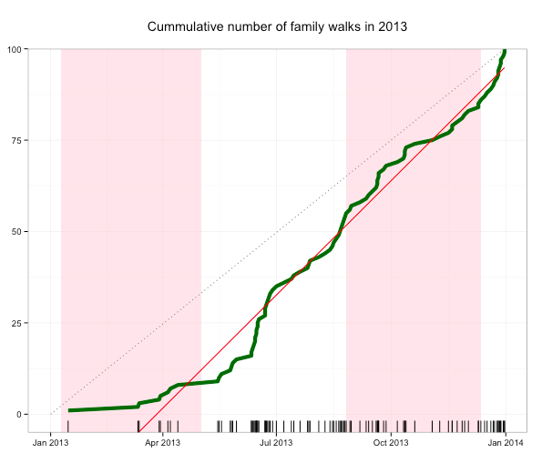
Lines
Bivariate visualization
Continuous + continuous
Why? | Univariate | Multivariate | Models | How?
Notes:
Add other parts of your data to get a better understanding of what’s going on
qsec = ¼ mile time

Slide 22
Filled lines
Bivariate visualization
Continuous + continuous
Why? | Univariate | Multivariate | Models | How?

Slide 23
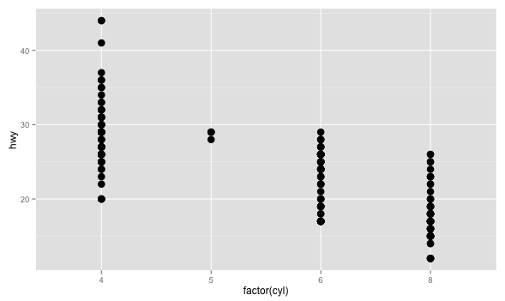
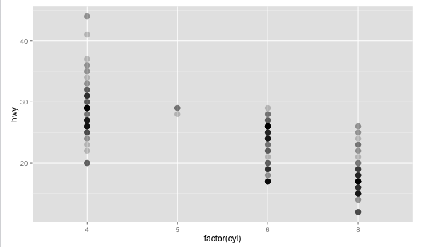
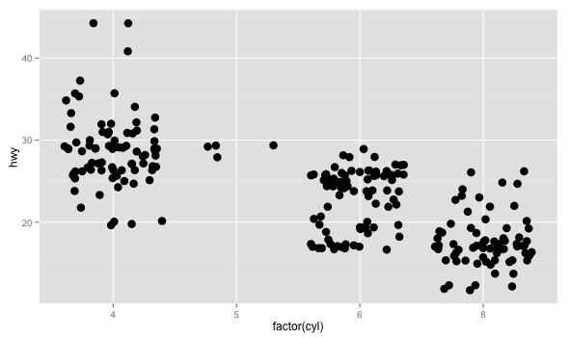
Grouped points
Bivariate visualization
Continuous + categorical
Why? | Univariate | Multivariate | Models | How?
Notes:
Add other parts of your data to get a better understanding of what’s going on – better than bar charts, since you can see all the data (bars hide the distribution)

Slide 24
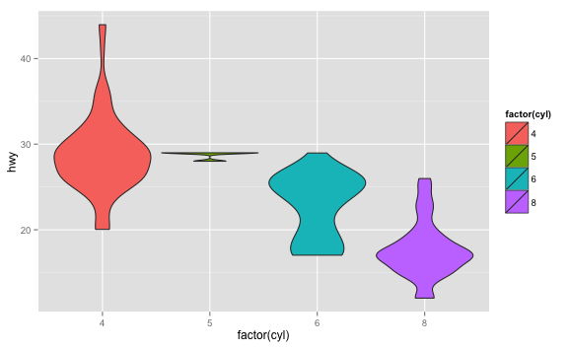
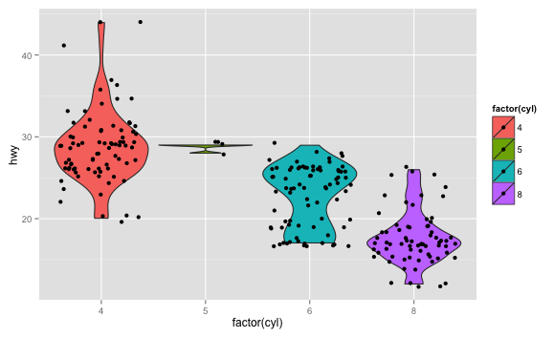
Violin plots
Bivariate visualization
Continuous + categorical
Why? | Univariate | Multivariate | Models | How?

Slide 25
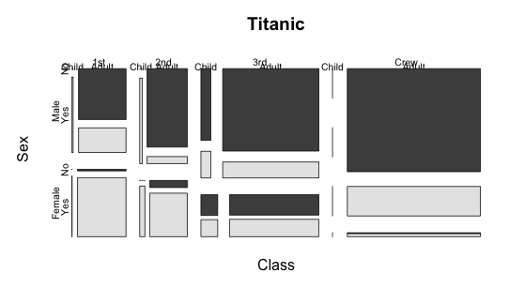
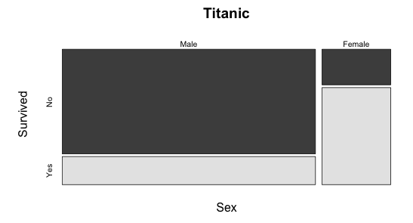
Mosaic plots
Bivariate visualization
Categorical + categorical
Why? | Univariate | Multivariate | Models | How?

Slide 26
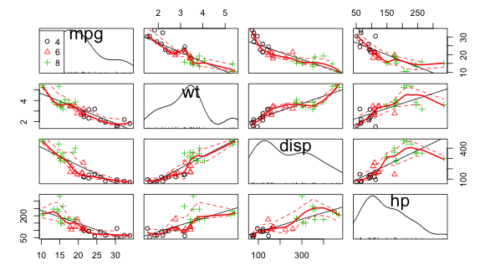
Scatterplot matrices
Model diagnostics
Regression
Why? | Univariate | Multivariate | Models | How?
Notes:
For collinearity

Slide 27
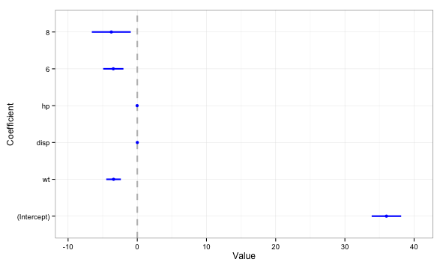
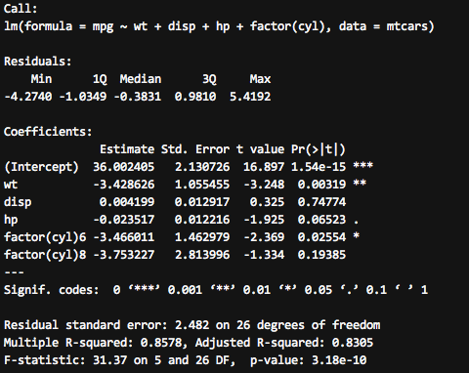
Coefficient plots
Model visualization
Regression
Why? | Univariate | Multivariate | Models | How?

Slide 28
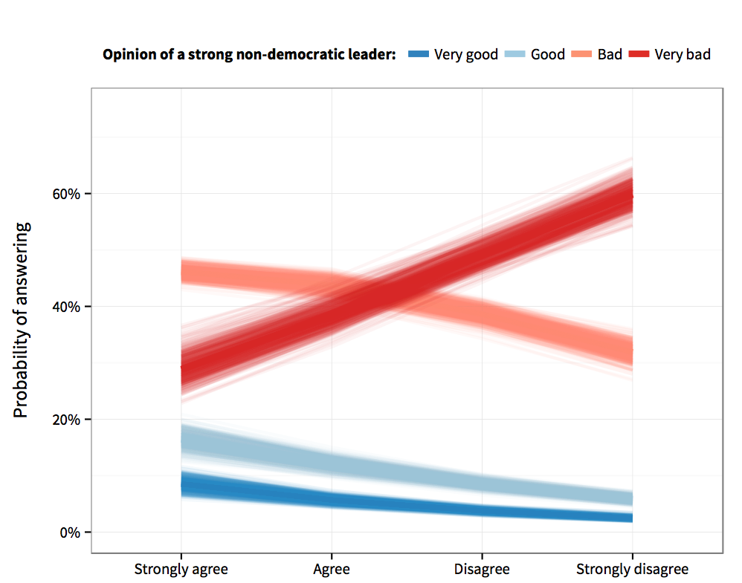
Predicted probabilities
Model visualization
Logit/Ologit
Why? | Univariate | Multivariate | Models | How?
Notes:
Nobody understands odds ratios. Convert them to predicted probabilities and plot them

Slide 29
Other models
Diff-in-diff (link to file)
Regression discontinuity (link to file)
Why? | Univariate | Multivariate | Models | How?
Notes:
Show stuff from PDFs?

Slide 30
How do I do all this?
Stata
R + ggplot2
Why? | Univariate | Multivariate | Models | How?
Notes:
Stata menus are incredibly useful and contain pretty much every option you need to graph 80%ish of the stuff here.
But Stata is not the greatest thing out there for graphics – it’s been discussed on their mailing lists
R produces publication-worthy graphics, especially with the ggplot2 package – based on the Grammar of Graphics, lets you add layers of data, get really dense, beautiful plots
R is another statistical programming language, but it’s fairly intuitive (and free and open source!). Plus you can technically do all your data cleaning and analysis in Stata and then just graph stuff in R – you just have to learn the basics of ggplot to get things working

Slide 31
How do I do all this?
Ask for help!
Why? | Univariate | Multivariate | Models | How?
Notes:
Stata menus are incredibly useful and contain pretty much every option you need to graph 80%ish of the stuff here.
But Stata is not the greatest thing out there for graphics – it’s been discussed on their mailing lists – not their comparative advantage
R produces publication-worthy graphics, especially with the ggplot2 package – based on the Grammar of Graphics, lets you add layers of data, get really dense, beautiful plots
R is another statistical programming language, but it’s fairly intuitive (and free and open source!). Plus you can technically do all your data cleaning and analysis in Stata and then just graph stuff in R – you just have to learn the basics of ggplot to get things working

Slide 32
Go make pretty pictures.
http://andhs.co/stataviz
http://andhs.co/statadata

